Slide 1





Customer
Management System
-by Sanchalika Datta

Slide 2
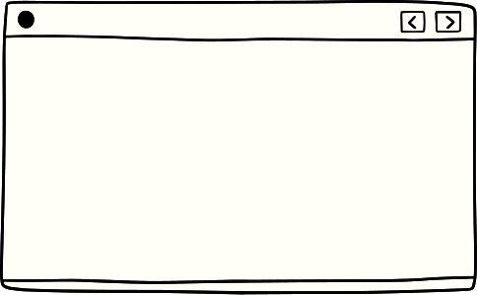


Contents
01
02
03
About
Flow Diagram
ER Diagram
04
05
06
Class Diagram
Outputs
Deployment

Slide 3
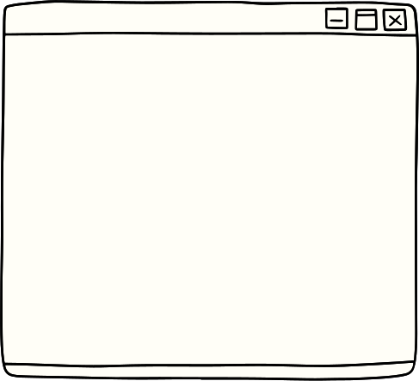

About the project
The Customer Management System is a core Java-based application designed to help businesses efficiently manage their customer information. It allows users to perform CRUD (Create, Read, Update, Delete) operations on customer data and provides a user-friendly interface to interact with the system.

Slide 4
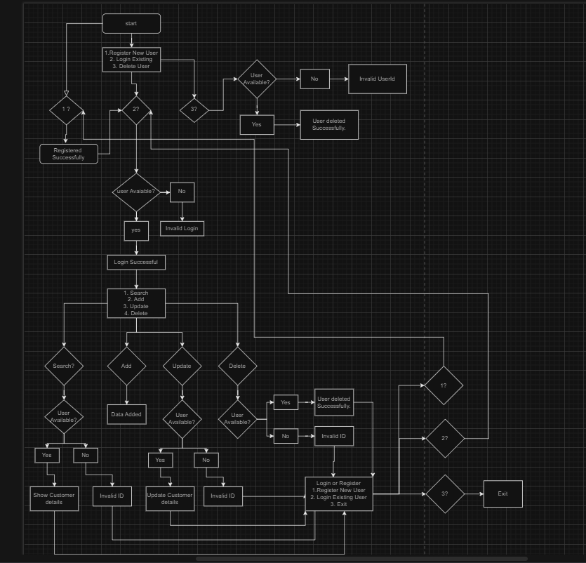
Flow Diagram

Slide 5
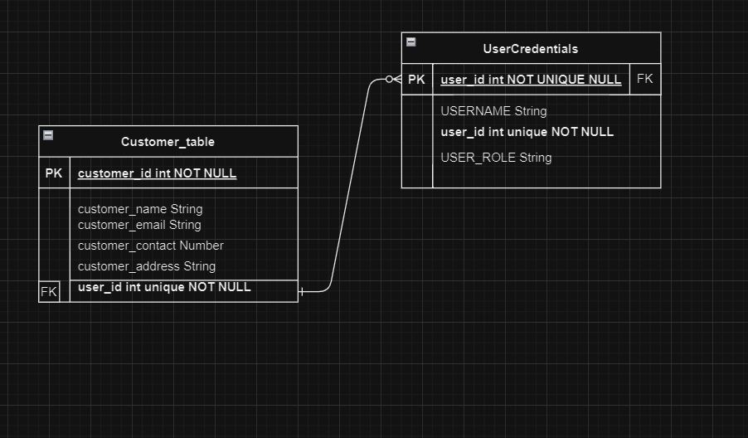
ER Diagram
USER_PASSWORD unique NOT NULL

Slide 6
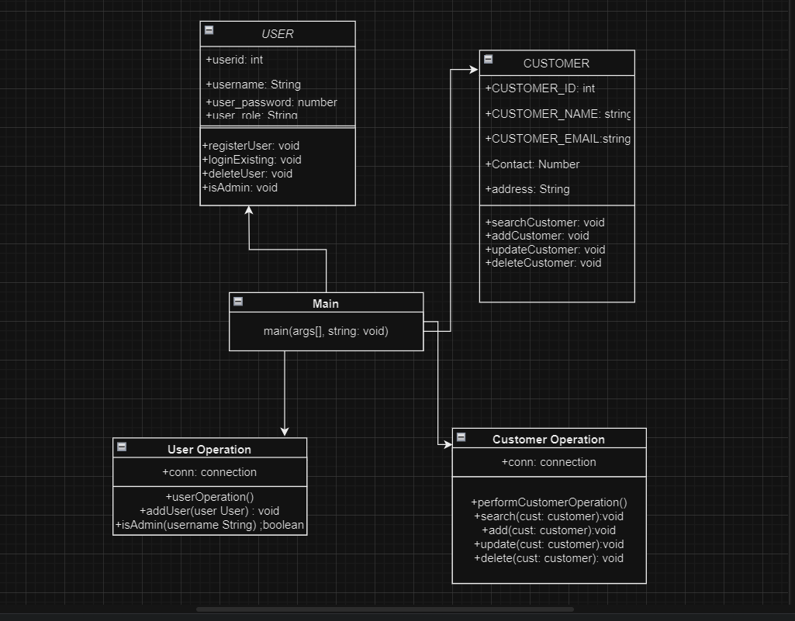
Class Diagram

Slide 7
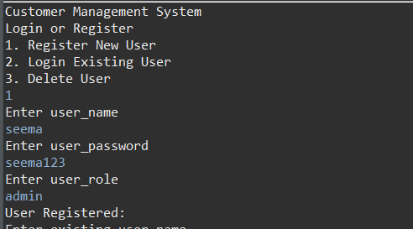
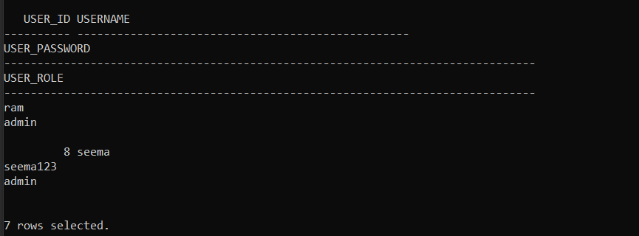
Codes
User Registration

Slide 8
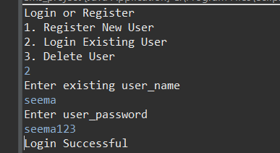
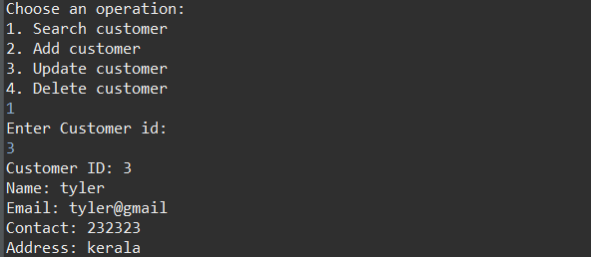
Login Existing Users
Search for Existing Users

Slide 9
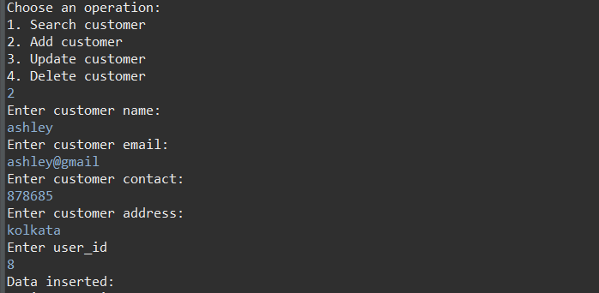
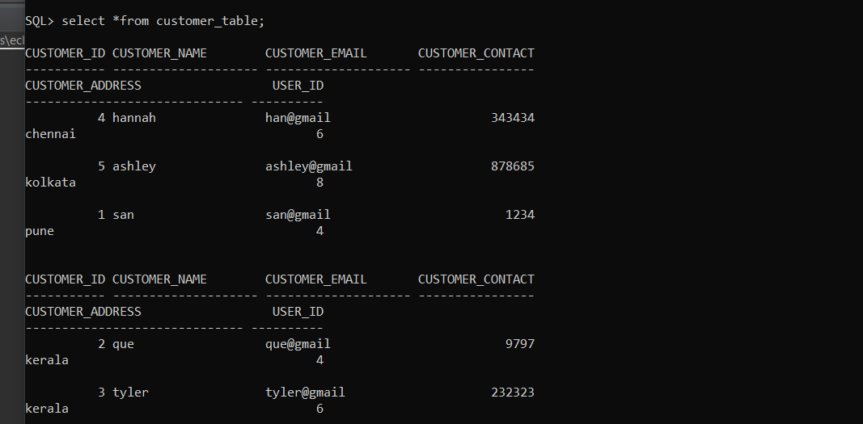
ADD Existing Users

Slide 10
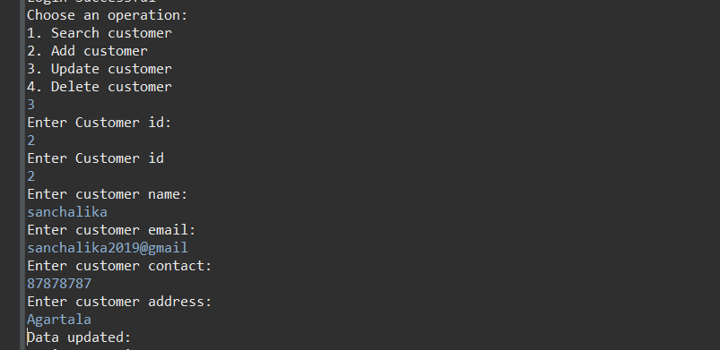
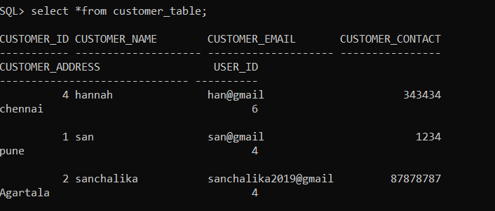
Update Existing Users

Slide 11
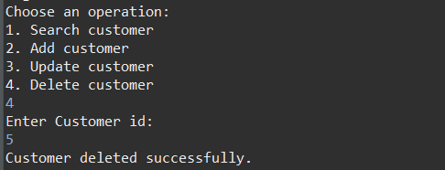
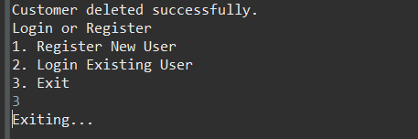
Delete Existing Users
Logout Existing Users

Slide 12
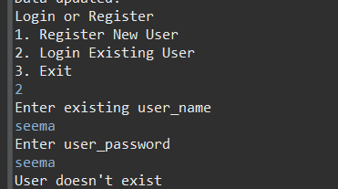
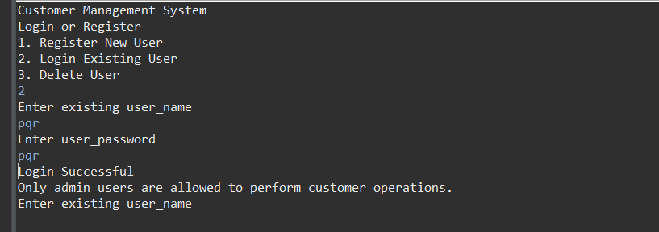
Data Validation
Admins Only

Slide 13
Logout Existing Users

Slide 14



Thank you

